Slide 1
Overview
Background
What is UML for?
Building blocks of UML

Slide 2
Unified Modeling Language (UML)
An effort by Rational to standardize OOA&D notation
  “a graphical language for visualizing, specifying, constructing, and documenting the artifacts of a software intensive system” [Booch]
UML attempts to combine the best of the best from
  Data Modeling concepts (Entity Relationship Diagrams)
  Business Modeling (work flow)
  Object Modeling
  Component Modeling
Offers vocabulary and rules for communication
Focus on conceptual and physical representations of a system
  Not a process but a language
Notes:
Redun; simpler

Slide 3
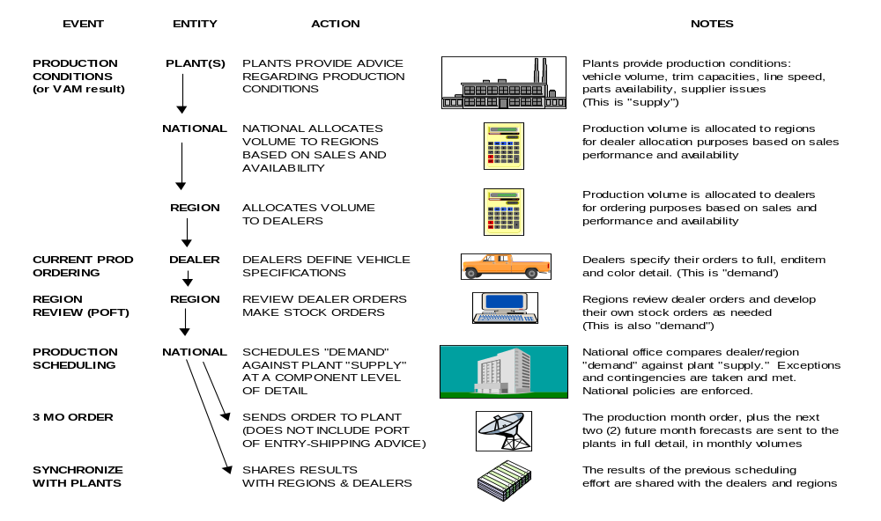
UML is for Visual Modeling
A picture is worth a thousand words!
- Uses standard graphical notations
- Semi-formal
- Captures Business Process from enterprise information systems to distributed Web-based applications and even to hard real time embedded systems
Business Process

Slide 4
UML is also for …
Specifying
building models that are: Precise, Unambiguous, Complete
UML symbols are based on well-defined syntax and semantics.
UML addresses the specification of all important analysis, design, and implementation decisions.
Constructing
Models are related to OO programming languages.
Round-trip engineering requires tool and human intervention to avoid information loss
  Forward engineering — direct mapping of a UML model into code.
  Reverse engineering — reconstruction of a UML model from an implementation.
Documenting
  Architecture, Requirements, Tests, Activities (Project planning, Release management)

Slide 5
Architecture & Views
UML is for visualizing, specifying, constructing, and documenting with emphasis on system architectures (things in the system and relationships among the things) from five different views
Architecture - set of significant decisions regarding:
  Organization of a software system.
  Selection of structural elements & interfaces from which a system is composed.
  Behavior or collaboration of elements.
  Composition of structural and behavioral elements.
  Architectural style guiding the system.
system assembly
configuration mgmt.
Design View
(Logical View)
Implementation View
vocabulary
functionality
Use Case View
behavior
system topology
distribution
delivery
installation
Process View
Deployment View
performance
scalability
throughput

Slide 6
Views
Use Case View
Use Case Analysis is a technique to capture business process from user’s perspective.
Encompasses the behavior as seen by users, analysts and testers.
Specifies forces that shape the architecture.
Static aspects captured in use case diagrams.
Dynamic aspects captured in interaction diagrams, statechart diagrams, and activity diagrams.
Design View (a.k.a. Logical View)
Encompasses classes, interfaces, and collaborations that define the vocabulary of a system.
Supports functional requirements of the system.
Static aspects captured in class diagrams and object diagrams.
Dynamic aspects captured in interaction, statechart, and activity diagrams.

Slide 7
Views
Process View
Encompasses the threads and processes defining concurrency and synchronization.
Addresses performance, scalability, and throughput.
Static and dynamic aspects captured as in design view; emphasis on active classes.
Implementation View
Encompasses components and files used to assemble and release a physical system.
Addresses configuration management.
Static aspects captured in component diagrams.
Dynamic aspects captured in interaction, statechart, & activity diagrams.
Deployment View
Encompasses the nodes that form the system hardware topology.
Addresses distribution, delivery, and installation.
Static aspects captured in deployment diagrams.
Dynamic aspects captured in interaction, statechart, & activity diagrams.

Slide 8
Three (3) basic building blocks of UML
  Things
  important modeling concepts
  Relationships
  tying individual things together
  Diagrams
  grouping interrelated collections of things and relationships

Slide 9
3 basic building blocks of UML - Things
Structural — nouns of UML models.
Behavioral — dynamic (verbal) parts of UML models.
Grouping — organizational parts of UML models.
Annotational — explanatory parts of UML models.

Slide 10
Structural Things in UML- 7 Kinds
Nouns of UML models ----- Conceptual or physical elements.
Active Class
Class
Collaboration
Event Mgr
thread
time
suspend( )
flush( )
stop( )
Window
origin
size
open( )
close( )
move( )
Chain of
Responsibility
Node
WebServer
Place
Order
listbox
IWindow
Use Case
Interface
Component

Slide 11
Structural Things in UML
name
attributes
operations
Window
1. Class
A description of a set of objects that share the same attributes, operations, relationships, and semantics.
origin
size
open()
close()
2. Interface
A collection of operations that specify a service (for a resource or an action) of a class or component. It describes the externally visible behavior of that element.
<<interface>>
IWindow
IWindow
name
operations
open()
close()

Slide 12
Structural Things in UML
3. Collaboration
Define an interaction among two or more classes.
Define a society of roles and other elements.
Provide cooperative behavior.
Capture structural and behavioral dimensions.
UML uses ‘pattern” as a synonym (careful)
Chain of
Responsibility
4. Use Case
A sequence of actions that produce an observable result for a specific actor.
A set of scenarios tied together by a common user goal.
Provides a structure for behavioral things.
Realized through a collaboration (usually realized by a set of actors and the system to be built).
Place Order

Slide 13
Structural Things in UML
5. Active Class
Event Manager
name
attributes
operations
Special class whose objects own one or more processes or threads.
Can initiate control activity.
Thread
time
Heavy border
suspend()
flush()
6. Component
Replaceable part of a system.
Components can be packaged logically.
Conforms to a set of interfaces.
Provides the realization of an interface.
Represents a physical module of code
Orderform.java
7. Node
Element that exists at run time.
Represents a computational resource.
Generally has memory and processing power.
WebServer
Variations on Structural Things: Actors, Signals, Utilities, Processes & Threads, Applications, Documents, etc.

Slide 14
Behavioral Things in UML
Verbs of UML models.
Dynamic parts of UML models: “behavior over time and space”
Usually connected to structural things in UML.
Two primary kinds of behavioral things:
Interaction
behavior of a set of objects comprising of a set of message exchanges within a particular context to accomplish a specific purpose.
display
State Machine
behavior that specifies the sequences of states an object or an interaction goes through during its lifetime in response to events, together with its responses to those events.
Idle
Waiting

Slide 15
Grouping Things in UML
Packages - one primary kind of grouping.
- General purpose mechanism for organizing elements into groups.
- Purely conceptual; only exists at development time.
- Contains behavioral and structural things.
- Can be nested.
- Variations of packages are: Frameworks, models, & subsystems.
Meeting Scheduler

Slide 16
Annotational Things in UML
Explanatory parts of UML models
Comments regarding other UML elements (usually called adornments in UML)
Note is the one primary annotational thing in UML
best expressed in informal or formal text.
flexible
drop-out dates

Slide 17
3 basic building blocks of UML - Relationships
4 Kinds
Dependency
Association
Generalization
Realization

Slide 18
Relationships in UML
1. Dependency
a semantic relationship between two things in which a change to one thing (independent) may affect the semantics of the other thing (dependent).
Directed is optional and label is optional.
employer
employee
0..1
*
Aggregation
a special kind of association. It represents a structural
relationship between the whole and its parts.
Represented by a black diamond.

Slide 19
Relationships in UML
3. Generalization
a specialization/generalization relationship in which objects of the specialized element (the child) are more specific than the objects of the generalized element.
4. Realization
a semantic relationship between two elements, wherein one element guarantees to carry out what is expected by the other element.
Where?
Between interfaces and classes that realize them…
Between use cases and the collaborations that realize them...

Slide 20
3 basic building blocks of UML - Diagrams
Graphical representation of a set of elements.
Represented by a connected graph: Vertices are things; Arcs are behaviors.
5 most common views built from 9 diagram types.
Class Diagram; Object Diagram
    Use case Diagram
    Sequence Diagram; Collaboration Diagram
    Statechart Diagram
    Activity Diagram
    Component Diagram
    Deployment Diagram

Slide 21
Diagrams in UML
– University Registration System as a Running Example
The UTD wants to computerize its registration system
  The Registrar sets up the curriculum for a semester
    One course may have multiple course offerings
  Students select four (4) primary courses and two (2) alternate courses
  Once a student registers for a semester, the billing system is notified so the student may be billed for the semester
  Students may use the system to add/drop courses for a period of time after registration
  Professors use the system to set their preferred course offerings and receive their course offering rosters after students register
  Users of the registration system are assigned passwords which are used at logon validation

Slide 22
Diagrams in UML – Actors in Use Case Diagram
An actor is someone or some thing that must interact with the system under development
Professor
Registrar
Student
Billing System

Slide 23
Diagrams in UML - Use Cases in Use Case Diagram
A use case is a pattern of behavior the system exhibits
  Each use case is a sequence of related transactions performed by an actor and the system in a dialogue
Actors are examined to determine their needs
  Registrar -- maintain the curriculum
  Professor – set course offerings and request roster
  Student -- maintain schedule
  Billing System -- receive billing information from registration
Maintain Curriculum
Request Course Roster
Maintain Schedule

Slide 24
Diagrams in UML - Documenting Use Cases in Use Case Diagram
A flow of events is described in documents for each use case
  Written from an actor point of view
Details what the system must provide to the actor when the use case is executed
Typical contents
  How the use case starts and ends
  Normal flow of events
  Alternate flow of events
  Exceptional flow of events

Slide 25
Diagrams in UML - Use Case Diagram
Use case diagrams are created to visualize the relationships between actors and use cases
Request Course Roster
Professor
Student
Set Course Offerings
Maintain Schedule
Billing System
Maintain Curriculum
Registrar

Slide 26
Diagrams in UML
– Flow of Events for Maintaining Curriculum and Setting Course Offerings
(Maintaining Curriculum and Setting Course Offerings are two of the activities in running university registration system)
Flow of Events for Maintaining Curriculum
This use case begins when the Registrar logs onto the Registration System and enters his/her password.
The system verifies that the password is valid and prompts the Registrar to select the current semester or a future semester.
The Registrar enters the desired semester.
Flow of Events for Setting Course Offerings
The system prompts the professor to select the desired activity: ADD, DELETE, REVIEW, or QUIT.
If the activity selected is ADD: Add a Course subflow is performed.
If the activity selected is DELETE: Delete a Course subflow is performed.
If the activity selected is REVIEW: Review Curriculum subflow is performed.
If the activity selected is QUIT, the use case ends.

Slide 27
Diagrams in UML
- Includes and Extends - Use Case Relationships in Use Case Diagram
An includes relationship shows behavior common to one or more use cases
An extends relationship shows optional behavior
<<includes>>
<<extends>>
Register for courses
<<includes>>
Register for
Distance Learning courses
Logon validation
Maintain curriculum

Slide 28
Diagrams in UML - Use Case Realizations
A use case diagram presents an outside view of the system.
Then, how about the inside view of the system?
Interaction diagrams describe how use cases are realized as interactions among societies of objects, including the messages that may be dispatched among them. They address the dynamic view of the system.
Two types of interaction diagrams
  Sequence diagrams
  Collaboration diagrams
Notes:
Execution of these two concurrent substates continues in parallel.

Slide 29
Diagrams in UML - Sequence Diagram
A sequence diagram displays object interactions arranged in a time sequence
: Student
registration
registration
math 101
math 101
form
manager
section 1
1: fill in info
2: submit
3: add course(Sue, math 01)
4: are you open?
5: are you open?
6: add (Sue)
7: add (Sue)

Slide 30
Diagrams in UML - Collaboration Diagram
Displays object interactions organized around objects and their direct links to one another.
Emphasizes the structural organization of objects that send and receive messages.
course form :
1: set course info
CourseForm
2: process
: Registrar
3: add course
aCourse :
theManager :
Course
CurriculumManager
4: new course

Slide 31
Diagrams in UML - Class Diagrams
A class diagram shows the existence of classes and their relationships in the logical view of a system
UML modeling elements in class diagrams
  Classes and their structure and behavior
  Association, aggregation, dependency, and inheritance relationships
  Multiplicity and navigation indicators
  Role names

Slide 32
Diagrams in UML - Classes
A class is a collection of objects with common structure, common behavior, common relationships and common semantics
Some classes are shown through the objects in sequence and collaboration diagram
A class is drawn as a rectangle with three compartments
Classes should be named using the vocabulary of the domain
  Naming standards should be created
  e.g., all classes are singular nouns starting with a capital letter

Slide 33
Diagrams in UML - Classes: Naming & 3 Sections
RegistrationForm
ScheduleAlgorithm
RegistrationManager
Course
Student
Professor
CourseOffering

Slide 34
Diagrams in UML – Classes: Operations & Attributes
Operations
The behavior of a class is represented by its operations
Operations may be found by examining interaction diagrams
registration
registration
RegistrationManager
form
manager
3: add course(Sue, math 01)
addCourse(Student,Course)
Attributes
The structure of a class is represented by its attributes
Attributes may be found by examining class definitions, the problem requirements, and by applying domain knowledge
CourseOffering
Each course offering
has a number, location and time
number
location
time

Slide 35
Diagrams in UML – Some Classes with Operations & Attributes
RegistrationForm
ScheduleAlgorithm
RegistrationManager
addStudent(Course, StudentInfo)
Course
name
numberCredits
Student
open()
name
addStudent(StudentInfo)
major
Professor
name
CourseOffering
tenureStatus
location
open()
addStudent(StudentInfo)

Slide 36
Diagrams in UML – Object Diagrams
Shows a set of objects and their relationships.
A static snapshot of instances.
Harry
(Student)
Name: “Harry Mat”
Major: CS
Sue (Professor)
Name: “Sue Becker”
tenureStatus: true

Slide 37
Diagrams in UML – Finding Relationships
Relationships are discovered by examining interaction diagrams
  If two objects must “talk” there must be a pathway for communication
Registration
RegistrationManager
Math 101:
Manager
Course
3: add student(Sue)
Course

Slide 38
Diagrams in UML – Relationships: Multiplicity and Navigation
RegistrationForm
ScheduleAlgorithm
0..*
1
RegistrationManager
addStudent(Course, StudentInfo)
Course
1
0..*
name
numberCredits
Student
open()
major
addStudent(StudentInfo)
1
3..10
Professor
1..*
4
CourseOffering
subjectStatus
location
1
0..4
open()
addStudent(StudentInfo)

Slide 39
Diagrams in UML – Inheritance
Inheritance is a relationship between a superclass and its subclasses
Common attributes, operations, and/or relationships are shown at the highest applicable level in the hierarchy
RegistrationForm
ScheduleAlgorithm
RegistrationManager
addStudent(Course, StudentInfo)
Course
RegistrationUser
name
name
numberCredits
Student
open()
major
addStudent(StudentInfo)
Professor
CourseOffering
tenureStatus
location
open()
addStudent(StudentInfo)

Slide 40
Diagrams in UML – State Transition Diagram
  The life history of a given class
  The events that cause a transition from one state to another
  The actions that result from a state change
Add student[ count < 10 ]
Add Student /
Initialization
Set count = 0
Open
do: Initialize course
entry: Register student
exit: Increment count
Cancel
Cancel
[ count = 10 ]
Canceled
do: Notify registered students
Closed
Cancel
do: Finalize course

Slide 41
Diagrams in UML – Statechart Diagram
shows a state machine, consisting of states, transitions,
events and activities
Add student[ Count < 10 ]
Initialization
Add student / Set count = 0
Open
[ Count = 10 ] ^Course
Report.Create report
Cancel course
Cancelled
Closed
Cancel course

Slide 42
Diagrams in UML – Activity Diagrams
A special kind of statechart diagram that shows the flow from activity to activity.
Customer Service
Fulfillment
Receive Order
Finance
Swimlanes
a mechanism to group and organize activity states
Send Invoice
Fill Order
Receive Payment
Deliver Order
Close Order

Slide 43
Diagrams in UML – Component Diagram
shows the organizations and dependencies among a set of
components.
Billing.exe
Register.exe
Billing
System
Registrar.exe
People.dll
User
Course.dll
Course
Courses.dll
People.dll
Student
Professor
Course
Course
Offering

Slide 44
Diagrams in UML – Deployment Diagram
The deployment diagram shows the configuration of run-time processing elements and the software processes living on them.
The deployment diagram visualizes the distribution of components across the enterprise.
Registration
Database
Library
Main
Building
Dorm

Slide 45
Extensibility of UML
  Stereotypes can be used to extend the UML notational elements (extends vocabulary.)
    Name shown in guillements <<stereotype>>
    Stereotypes may be used to classify and extend associations, inheritance relationships, classes, and components
    Examples:
      Class stereotypes: boundary, control, entity, utility, exception
        Inheritance stereotypes: includes and extends
        Component stereotypes: subsystem
  Tagged values — extends properties of UML building blocks.
  Placed in braces beneath the name of the element to which the property applies
  Constraints — extend the semantics of UML building blocks.
  A string placed in braces
    {if Order.customer.credit.Rating is “poor” then Order.isPrepaid must be true}
anObject:ClassA
{location=server)

Slide 46
Using UML Concepts in a Nutshell
  Display the boundary of a system & its major functions using use cases and actors
  Illustrate use case realizations with interaction diagrams
  Represent a static structure of a system using class diagrams
  Model the behavior of objects with state transition diagrams
  Reveal the physical implementation architecture with component & deployment diagrams
  Extend your functionality with stereotypes

